Slide 1
UC Case Study: NPS and Key Drivers
Customer Experience, Insights,
& Analytics Team
Jan. 25, 2019

Slide 2
Agenda
Meet the CX Team
Project Objective
Overview of Relationship Survey
Brief introduction to Net Promotor Score
UC case study
Questions from UC Master of Business Analytics Students

Slide 3

Project Objective
Categorize key drivers of NPS score, identify areas of growth, and rank opportunities for two key populations, Agents and Policy Owners to build upon Ameritas' purpose-driven mission of fulfilling lives.

Slide 4
Our Core Objectives
It is all about the CONSUMER: As the forces shaping consumer behavior and expectations continue to evolve, we believe the following will become the new reality:
Access – multiple access points
Personalized – customers expect personalized content
Well-being – companies must focus on well-being of consumers
Purpose Driven – more loyalty towards consistent brand promise
Experience – expectations will defined by leading companies regardless of product, service, or industry

Slide 5
Opportunity for Ameritas
Increase customer retention & loyalty
Decrease cost of acquisition
Decrease cost to serve

Slide 6

Who is the Customer Experience (CX) team?
Linda Essman
CRM Specialist
Sara Horner Marketing Research Manager
Jennifer Kelly
Data Scientist
Nitish Ghosal Data Scientist
Dru Estrada Intern
Trinette K. James Director of CX, Insights & Analytics
Tarjani Shah
Data Scientist
Lindsay Stille CRM Specialist

Slide 7
CX goal
The CX Team seeks to unify the customer experience across all lines of business and channels by utilizing data and resources to provide knowledge and actionable insights necessary to make data-informed decisions that lead to individualized customer experience, increased sales and brand awareness.

Slide 8
Survey Methodology
Audience
Policy owners (IND) and Plan Participants (RP)
Producers (all LOBs)
Schedule
Policy owners and Plan Participants – Annually
Producers – 2 to 4 times per year, depending on LOB
Questions
The surveys consist of seven questions which assess the recipient's evaluation of Ameritas, including its products and services.

Slide 9
Survey Questions
Question # | Question | Response Options
1 | On a scale from 0-10, how likely are you to recommend Ameritas to your friends, family or peers? | NPS question 0-10 scale - not likely to recommend/extremely likely to recommend
2 | Why did you rate your likelihood to recommend Ameritas as you did? | Open Text
3 | How easy is Ameritas to work with? | On a scale from 1 = not easy at all to 7 = very easy, 4 = "neutral"
4 | Given all of your experiences with Ameritas, how would you rate our overall performance? | On a scale from 1 = poor to 7 = excellent, 4 = "neutral"
5 | Overall, how would you rate our communication with you? | On a scale from 1 = poor to 7 = excellent, 4 = "neutral"
6 | What is your preferred method of communication? | email, mail, phone, face-to-face, FAX
7 | How can we improve your experience with our company? | Open Text

Slide 10
Relationship Survey
Goal: To survey all policy owners or plan participants in order to measure the loyalty that exists between Ameritas and its end consumers.
Background: The CX Team launched the first-ever Relationship Survey in December 2018.

Slide 11
Agent Engagement Survey
Goal: To survey all brokers, financial professionals and other key roles within the lines of business, in order to measure the loyalty that exists between Ameritas and its producers.
Background: The CX Team has launched producer surveys for all product lines to include: Retirement Plans (RP), Ameritas Investment Corporation (AIC), Ameritas Group (Group), and the Individual Division (IND).

Slide 12
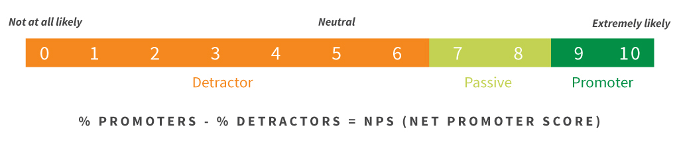
Net Promoter Score
Industry agnostic measure of brand loyalty considered one of the best barometers of a company’s success.
On a scale from 0-10, how likely are you to recommend Ameritas to a friend or colleague?

Slide 13
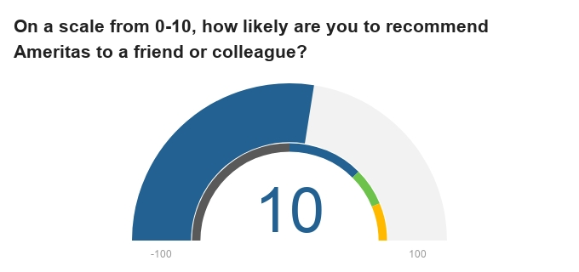
Net Promoter Score
On a spectrum of -100 to 100, NPS benchmarks as follows:
> 0 = Good
> 50 = Excellent
> 75 = World Class

Slide 14
Net Promoter Score
Key takeaways
Highly volatile
Not to be used in isolation; balance with other metrics and gather insights from qualitative follow-up
Best used to address issues in real time

Slide 15
Deliverables
What are the key drivers for our NPS score?
What themes would allow for us to gain maximum lift to our NPS score?
How do we increase our NPS score by 5 points?
Provide source code for scoring model that can be utilized for future surveys.

Slide 16
Potential Starting Points
Clustering/Segmentation
Supervised Learning Techniques
Text Analytics/NLP
Feature Engineering

Slide 17
Questions?

